Slide 1

Telecom Churn Predictions
Group 2:
Markus Lim En Cheng
Tong Ying
Yu Seung Yeon

Slide 2

Customer Churn: Rate at which customers unsubscribe from a company’s products/services

Slide 3

Importance of Customer Churn
Understand which proportion of customers leave after a period of time
Businesses can cater their services to retain customers
Telecom industry: 77% of customers are shifting between brands faster than 3 years ago (Accenture, 2024)

Slide 4
Predict which customers will churn or not churn.

Slide 5
DATASET
https://www.kaggle.com/datasets/blastchar/telco-customer-churn

Slide 6
Dataset Information
Churn: Whether customer left within the last month
Services: Phone, Multiple lines, Internet etc.
Account Information: Tenure, Type of contract, Payment method etc.
Customer Demographic: Gender, Age etc.

Slide 7
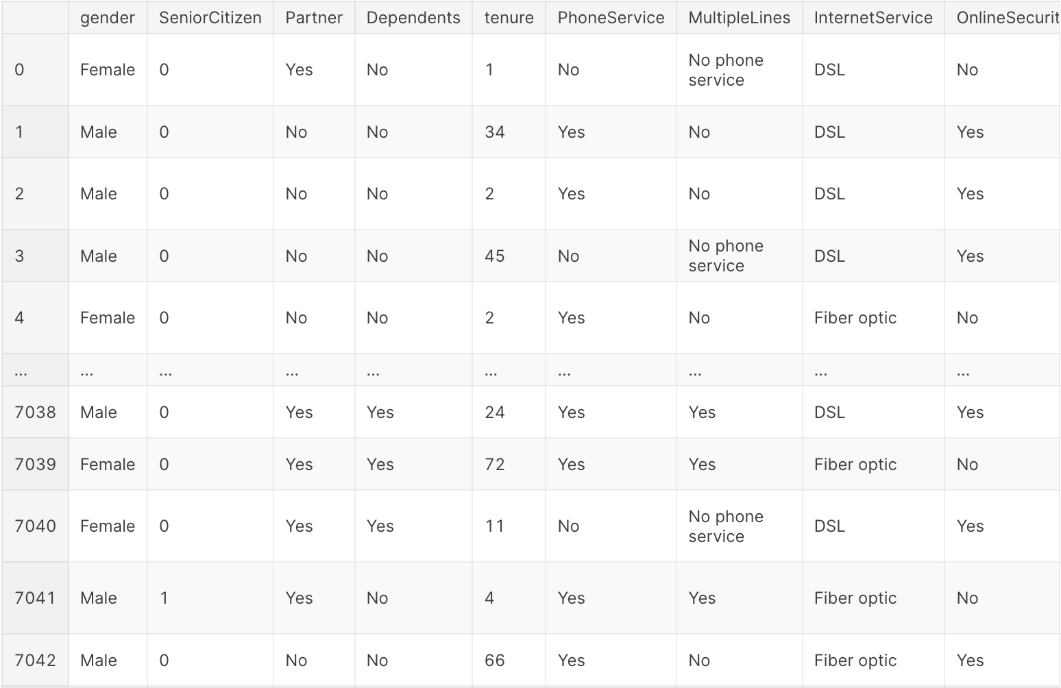
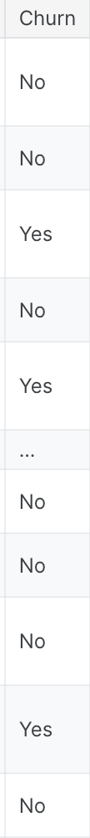
Dataset Information

Slide 8
3min
Present your Exploratory Data Analysis and some initial data-driven Insights from the dataset.
You MAY also mention how you are planning to set up the Analysis / ML problem for this case.
You MUST mention how you collected / curated / cleaned / prepared the data for this problem.
Did you only use tools and techniques learned in this course? What ELSE did you learn / try?

Slide 9
DATA PREPARATION

Slide 10
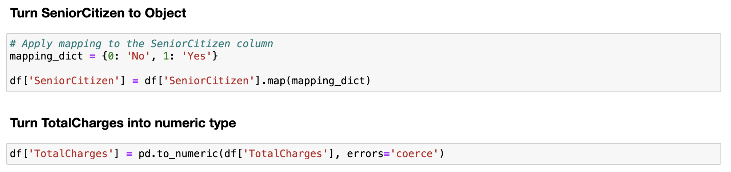
Dataset Preparation
Standardised the data type for each variable according to its context

Slide 11
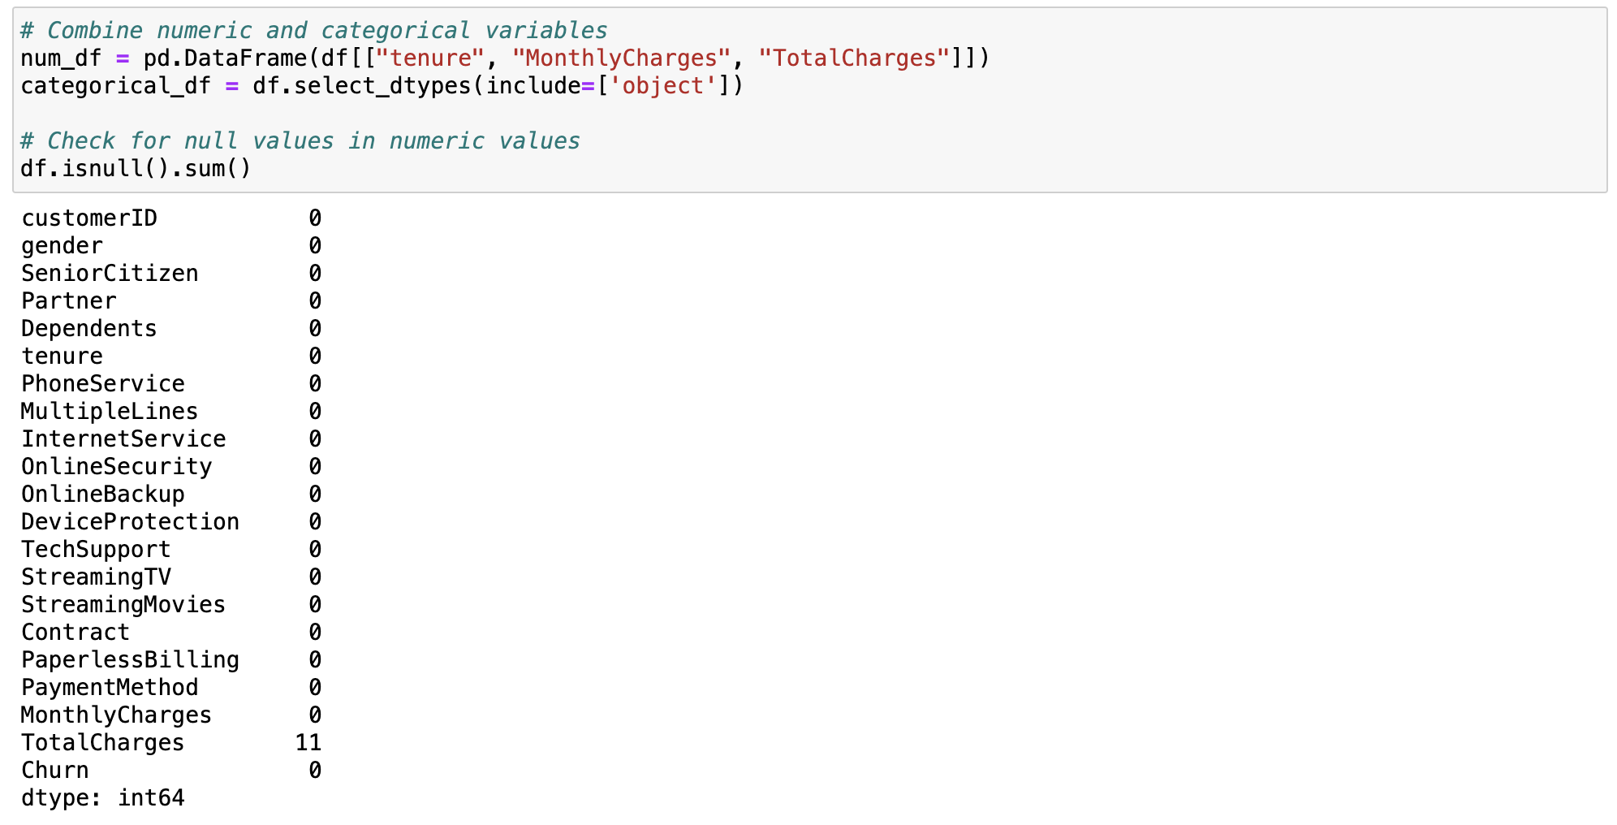
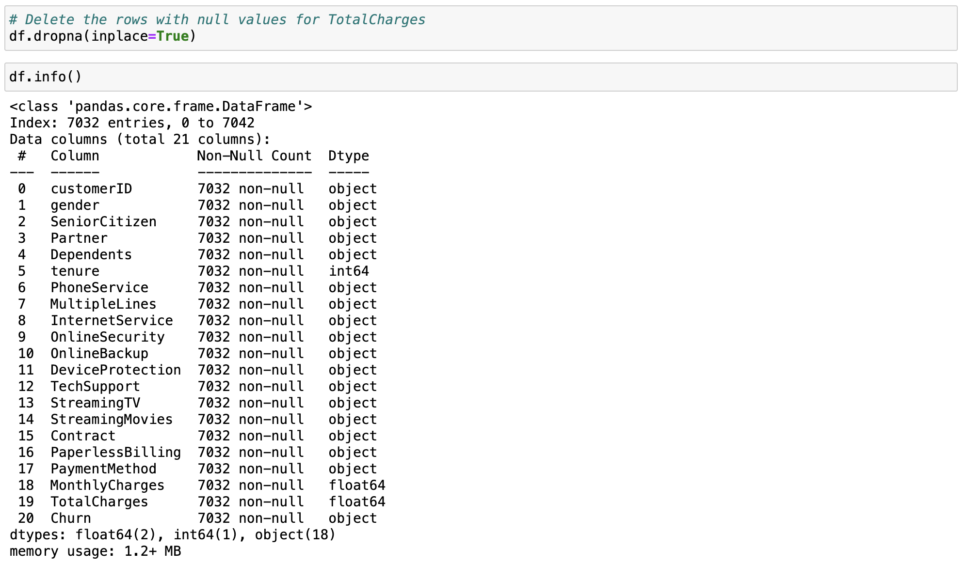
Dataset Preparation
Checked for null values

Slide 12
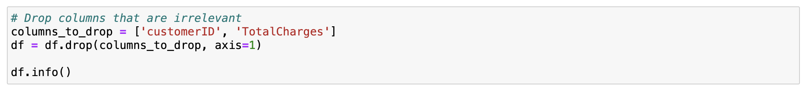
Dataset Preparation
Removed irrelevant columns

Slide 13
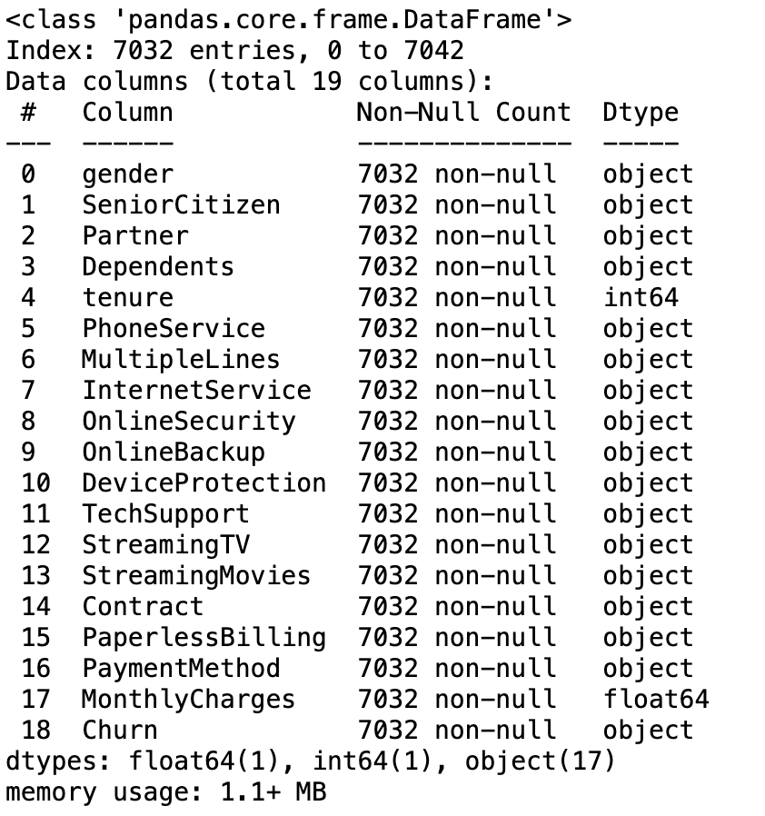
Dataset Preparation
Final dataset

Slide 14
DATA VISUALISATION

Slide 15
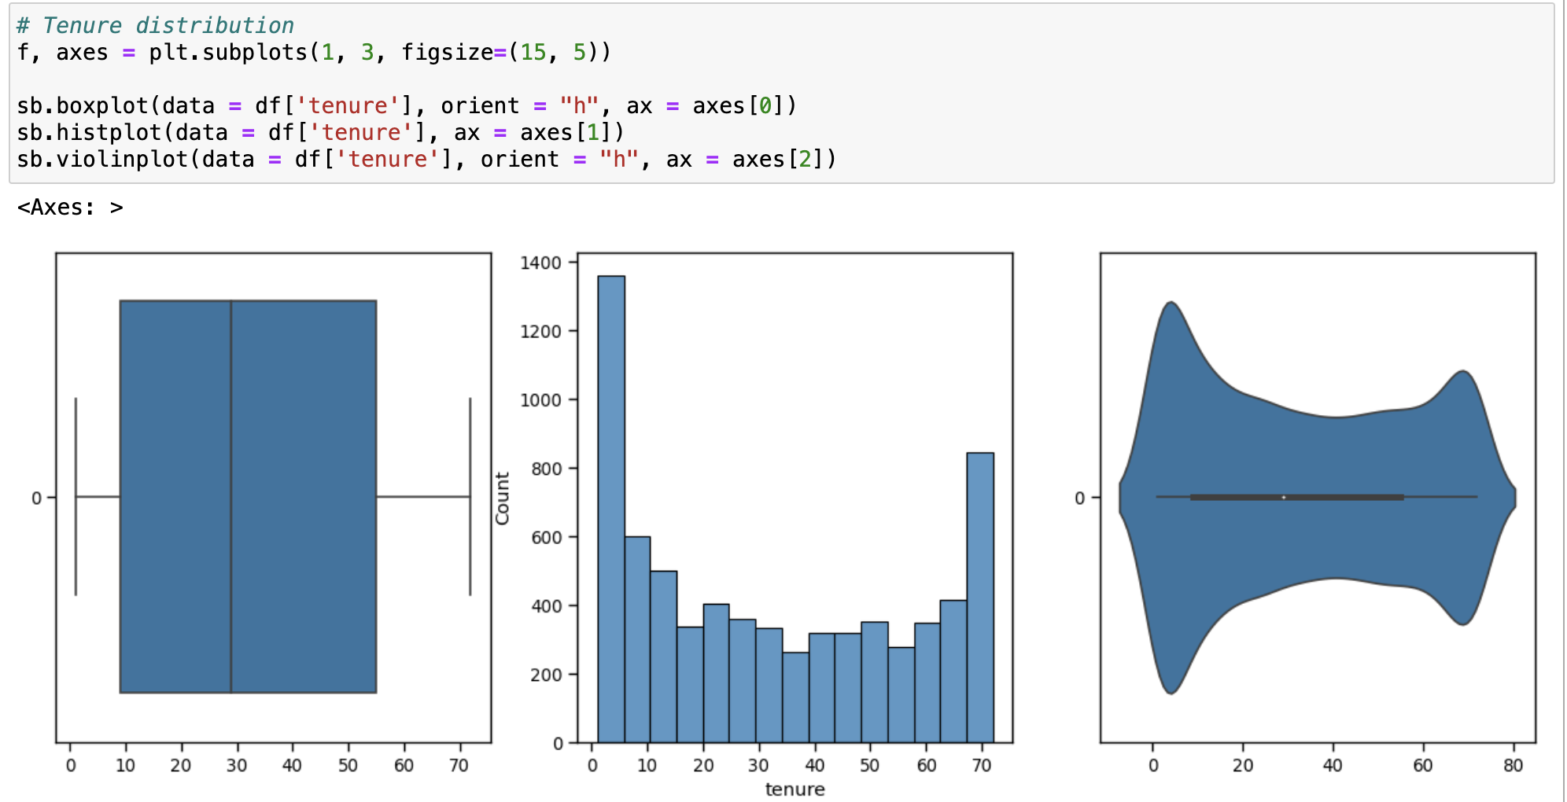
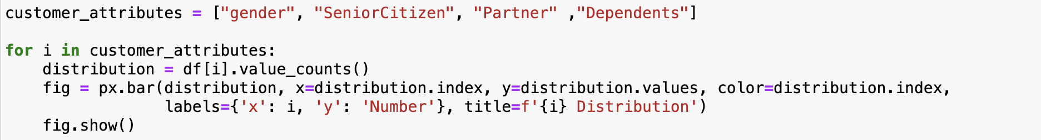
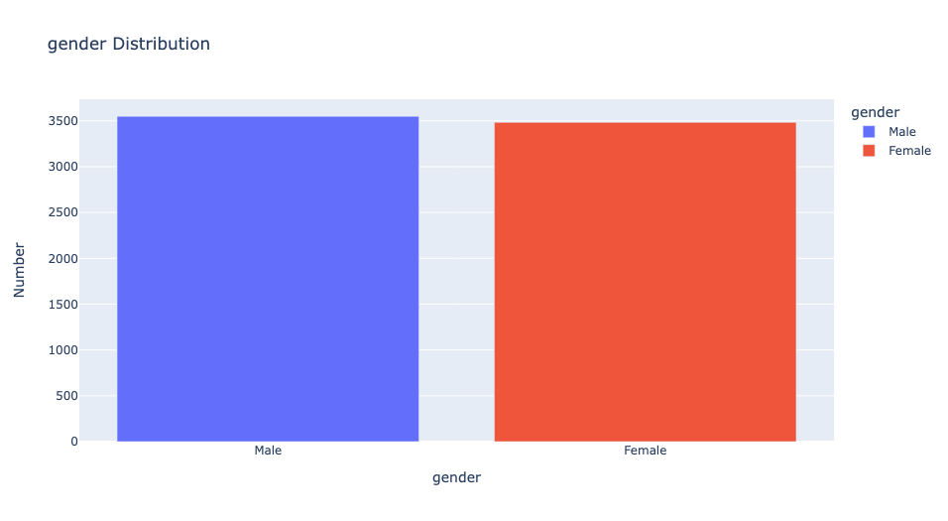
Univariate Analysis
Numerical Variables
Categorical Variables

Slide 16
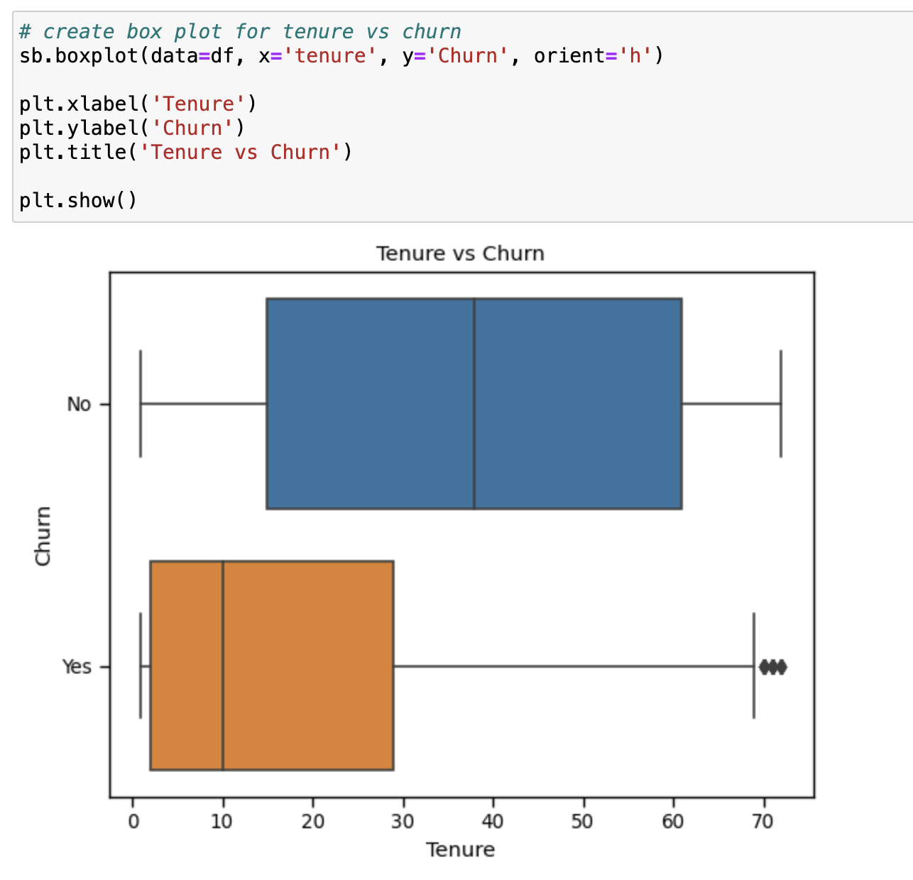
Bivariate Analysis
Between numerical and Churn (categorical) variables:
Boxplot
Able to see the distribution of Tenure for Churn and No Churn
Detect if there are differences between central tendency and spread
Eg. Customers with shorter tenure periods are more likely to churn.

Slide 17
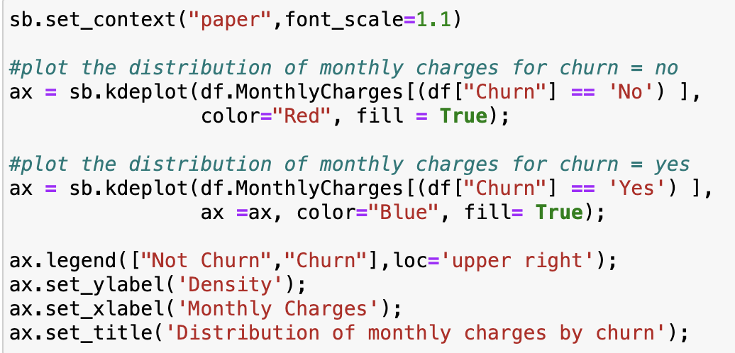
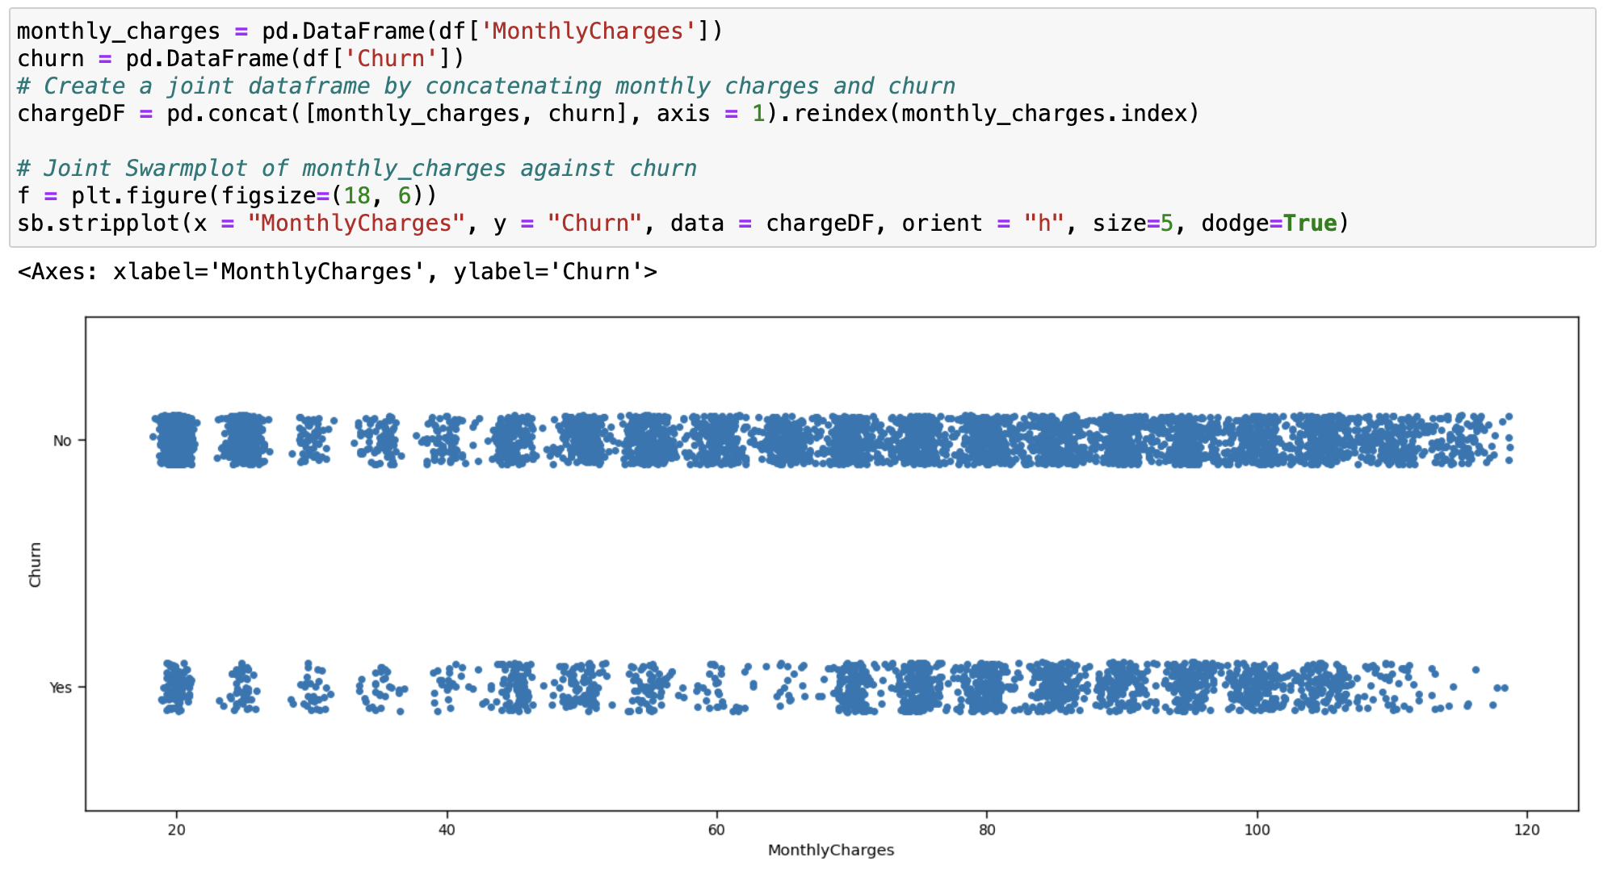
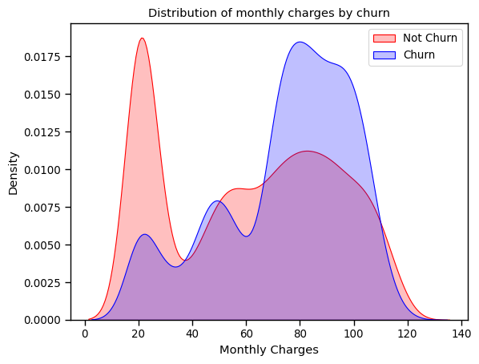
Bivariate Analysis
Between numerical and Churn (categorical) variables:
Swarmplot/ Kernel Density Estimation (KDE) Plot
Clearer visualization of distribution as density of datapoints can be seen
Able to detect peaks for each category

Slide 18
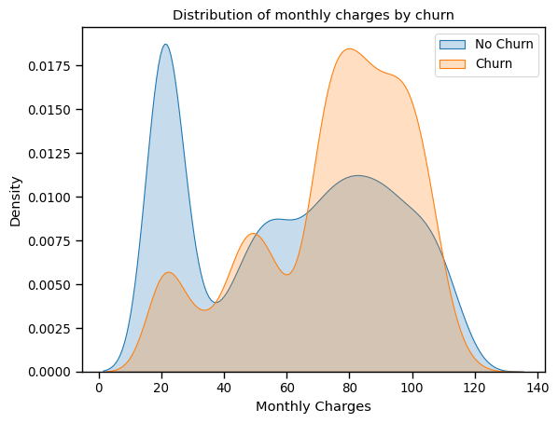
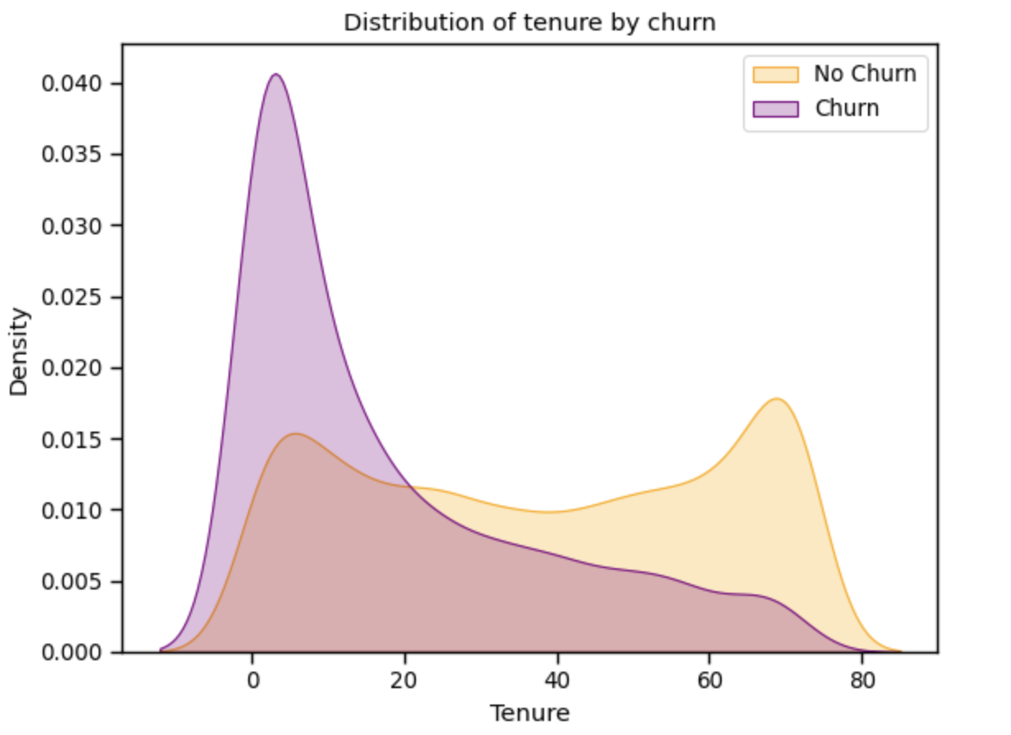
Bivariate Analysis
Between numerical and Churn (categorical) variables:
Monthly Charges vs Churn: Overlapping peaks for Churn and No Churn suggests less correlation.
Tenure vs Churn: Lower tenure periods has a high proportion of Churn while higher tenure periods has near zero Churn and mostly no Churn, suggesting a higher correlation.

Slide 19
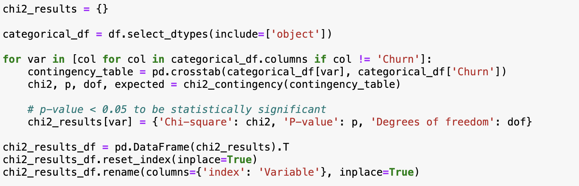
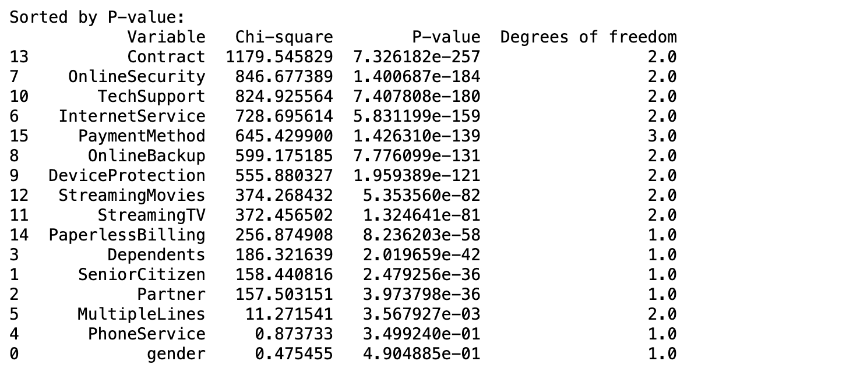
Bivariate Analysis
Between categorical variables (other variables vs Churn):
Chi-square Test
Null hypothesis: No association between variable X and Churn.
Alternative Hypothesis: Exists association between X and Churn.
The higher the chi-square statistic and lower the p-value, the less supported the null hypothesis, indicating higher correlation between the two variables.

Slide 20
Predict Churn from:
Tenure, Contract, Online Security, Tech Support, Internet Service

Slide 21
DATA PREPROCESSING

Slide 22
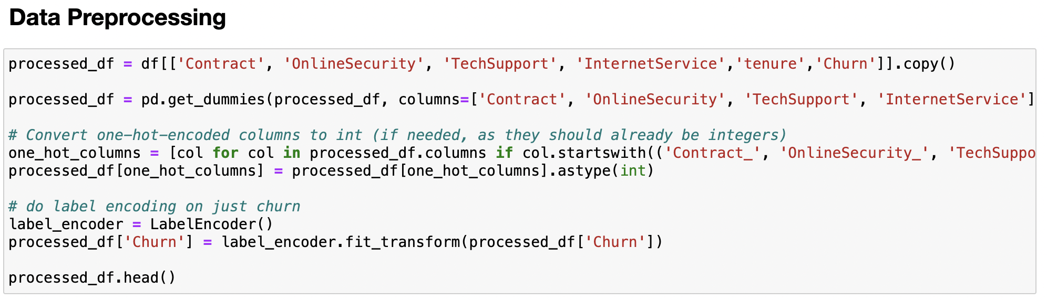
Data Preprocessing – Encoding Techniques
One hot encoding on variables with >2 values
Contract
Online Security
Tech Support
Internet Service
Label encoding on Churn
Churn only has Yes/No

Slide 23
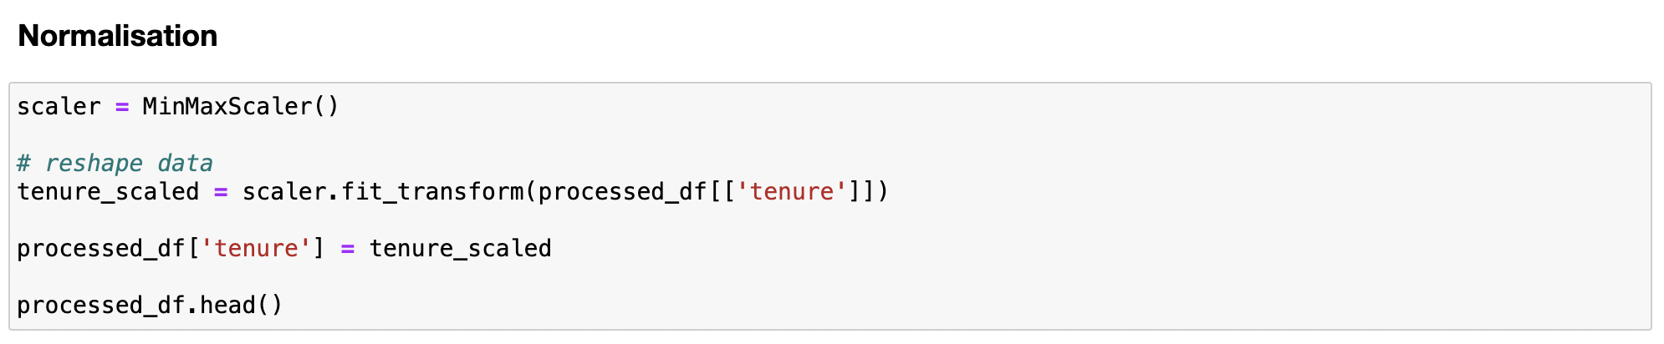
Data Preprocessing – Feature Scaling
Feature Scaling: Normalisation
Tenure is in terms of months which ranges from 1 to 72
Use MinMax Scaler to transform data to range from 0 to 1

Slide 24
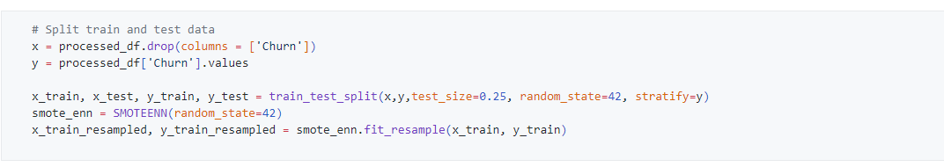
Data Preprocessing – Resampling Techniques
Resampling using SMOTEENN
Dataset has significantly more No values (75%) than Yes values (25%)
To resolve class imbalance, SMOTEENN combines over-sampling the minority and under-sampling the minority class

Slide 25
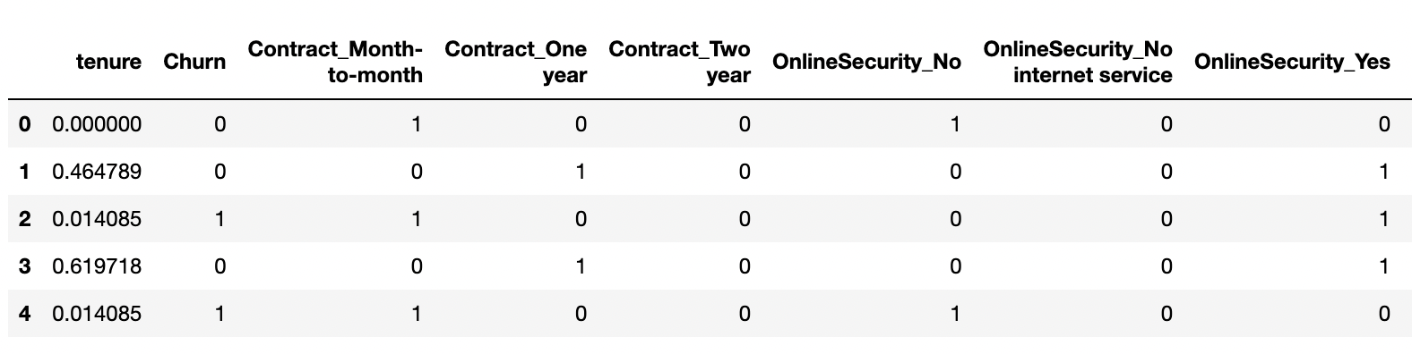
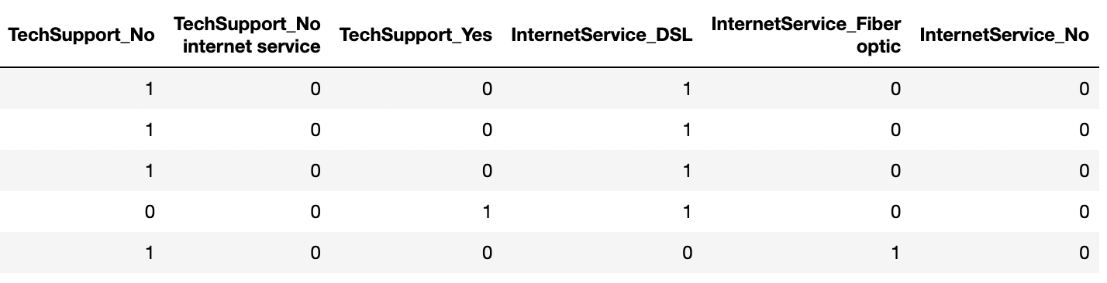
Final data

Slide 26
3min
If you used ML (regression, classification, or something else); mention mainly WHICH one(s).
You may now briefly CLARIFY why and how the ML problem(s) aim(s) to solve your objective.
How did you apply ML technique(s) to SOLVE your problem? Which model(s), how and why?
Did you only use tools and techniques learned in this course? What ELSE did you learn / try?

Slide 27

ML MODELS
Notes:
So moving onto our Machine learning models,

Slide 28




Machine Learning Algorithms
K-Nearest Neighbours
Support-Vector Machines
Algorithm that classifies based on the closest neighbour
Algorithm that draws a hyperplane to separate data
Random Forest
Neural Network
Algorithm that classifies by aggregating data from multiple decision trees
Simple 2-layer NN with regularisation
Notes:
We used 3 machine learning algorithms and 1 ann.

Slide 29
Machine Learning Algorithms
K-Nearest Neighbours
Random Forest
Support-Vector Machines
Algorithm that classifies based on the closest neighbour
Algorithm that classifies by aggregating data from multiple decision trees
Algorithm that draws a hyperplane to separate data
These algorithms were mainly chosen for their known performance and robustness at classification with smaller dataset size.

Slide 30
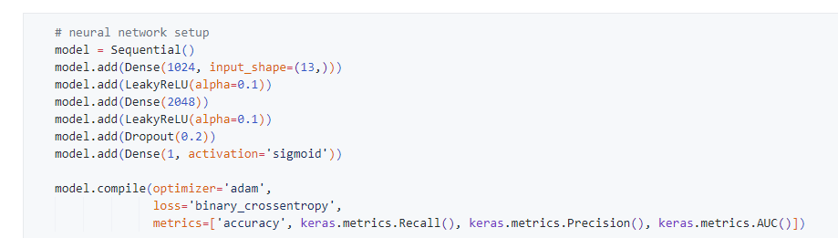
Neural Network
Architectural Overview
Layers
Activation
Regularisation
Loss / Optimiser
2 inner layers, with the final output layer mapping down into a yes/no churn that acts as our prediction
Pass the network through LRelu as the activation function to inject non-linearity into the neural network
To prevent overfitting as our dataset is relatively small, we added 2 regularisation techniques
Binary cross entropy is appropriate given our binary classification task, and Adam was used to backpropagate with the default learn rate
Notes:
Moving onto the architectural overview of our neural network, it is a simple neural network with 2 inner layers, with the final output layer being our prediction. To inject non-linearity into our model, we chose Lrelu as our activation function. Despite our dataset and number of variables being small, to prevent overfitting, we also added a dropout layer. A binary cross entropy loss function was selected given our binary classification task and was optmised using ADAM

Slide 31
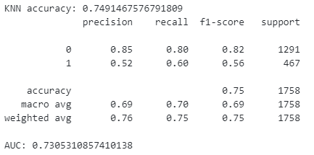
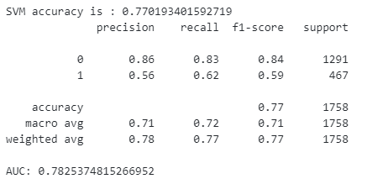
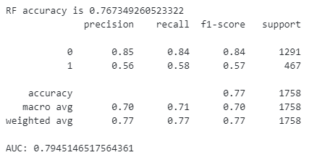
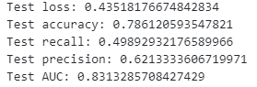
Results
K-Nearest Neighbours
Support-Vector Machines
Random Forest
Neural Network

Slide 32
Conclusion – Best Model
Context
Avoid churn, thus prioritising models that better identify positive cases
Prefer false positives over false negatives
Support Vector Machine
Highest Recall
Comparable Accuracy
Comparable AUC

Slide 33
Outcomes
ML models
Can be used to predict churn based on these attributes highly accurately, with models achieving ~75%
Learnt how to use different models and their strengths and weaknesses
Trends noticed
Considerations
Newer customers were more likely to churn
Customers with month-to-month contracts were more likely to churn compared to longer contracts
Consider long-term incentives to convince customers to stay or emphasise marketing their longer term contracts
Customers with no tech support were more likely to churn
Customers with fiber optic internet service were more likely to churn than DSL or people with no internet services
Improve tech support they offer, in order not to lose to their competitors
Research into potential reasons why customers with fiber optic are more likely to churn (eg. due to price, poor performance)

Slide 34
Data driven insights
Trends noticed
Considerations
Newer customers were more likely to churn
Customers with month-to-month contracts were more likely to churn compared to longer contracts of 1 year and 2 years
Consider long-term incentives to convince customers to stay or emphasise marketing their longer term contracts
People with no tech support were more likely to churn
People with fiber optic internet service were more likely to churn than DSL or people with no internet services
Improve tech support they offer, in order not to lose to their competitors
Find out why customers with fiber optic are more likely to churn, could be due to price or the fact that their fiber optic services are not delivering the expected performance

